Slide 1
Wine Competitions
Or, “How I Spent My Summer Quarantined”
Greg Stricker,
Missouri Winemaking Society

Slide 2
What we’ll cover
Goals/reasons for competing
Considerations for wine competitions
Preparing your entries
Shipping
Which contest(s) to enter?
Three tiers of contests
When you get your feedback sheets …

Slide 3
Why compete?
Get “impartial” evaluation of your wines by multiple people
Get evaluated in accordance with established, understood standards
Evaluate wines with lower-cost events to help determine entries in higher cost/prestige events
Subject wines to judges unfamiliar with French hybrids
It’s fun!
Win medals & be famous
Something to do while social distancing
You’re retired and have nothing better to do

Slide 4
Considerations for Wine Competitions
Cost per entry
Number of bottles per entry
Shipping distances & costs
Relative difficulty of each competition
Time of year – are your wines ready?
Impact of Covid-19
Carefully read entry documents
Selecting wine for competitions

Slide 5
Preparing Your Entries
Most require corked bottles; wire hoods for sparkling wines
How many bottles per entry – 1 or 2
Presence or absence of your regular bottle labels
No capsules
Make sure your bottle is sparkling clean & undamaged
Affix contest labels with clear tape unless otherwise specified
ALWAYS include a copy of your entry form in the box

Slide 6
Shipping
Case of 12 bottles weighs about 37lb.
Has to be carried into the shop
I pay $27 - $52 to ship case of 12 to contests ($2.25 - $4.33 each)
West coast shipping is the most expensive
Each 12 bottle shipper from U-Haul costs $12 new
Per bottle avg. $20 entry, $4.33 shipping & $1 packaging = $25.33

Slide 7
Shipping, Cont’d
This is where it gets tricky
Against Federal law to ship via USPS (Post Office)
UPS & FedEx have policies against it, but not “illegal”
Use really good packaging – it will need it
Watch wording on address label: Avoid “Winery” or “Wine Contest”
No label on box declaring it full of alcoholic beverages
Have a back story for what’s in the box. “I make specialty pickles and sell them on the Internet” or “pickles for my cousin Vinny”

Slide 8
Shipping Euphemisms
Food Samples for Evaluation
No Commercial Value - Not Perishable
Conforms to IRS and FDA Restrictions
Not Taxable per 27CFR24.75
HANDLE AS GLASS
Sample for Organoleptic Testing - as practiced in the food industry today - involves trained inspectors who assess food on the basis of taste, odor, color, texture, and appearance. Among the major types of organoleptic testing used are: Difference testing, which identifies differences from one sample to another.

Slide 9
Shipping, concluded
It is not against any Bureau of Alcohol, Tobacco and Firearms (ATF) regulation or federal law to ship your entries via privately owned shipping company (UPS or FedEx) for analytical purposes. However, IT IS ILLEGAL TO SHIP ALCOHOLIC BEVERAGES VIA THE U.S. POSTAL SERVICE. Private shipping companies have the right to refuse your shipment if they are informed that the package contains glass and alcoholic beverages. Entrants can identify package contents as “State Fair Exhibit”.

Slide 10
Which Contests to Enter?
Keep in mind:
Perceived value of contest
Overall cost
Time of year (e.g., heat of summer)
Entry vs. receipt of wine deadlines
Will your wine be in the bottle?
Shipping times (I allow at least one week)
Visit the websites; not always up-to-date
Cost concerns of entering many contests

Slide 11
Which Contests to Enter?
Base Tier: Basic wine competitions, run by other amateurs, usually lower price, e.g. Knob Noster, Kansas City Cellarmasters, LA Cellarmasters. Generally lowest cost
Mid-Tier: Has something setting it apart from the lower tier. E.g., New Jersey State Fair uses AWS judges; Illinois State Fair; Indy International; Musto and TVOS use people in the wine industry.
High-End: Prestigious and/or expensive. Uses quality, trained judges under controlled conditions. Large contests. Examples: AWS, Wine Maker Magazine, Bottle Shock, Finger Lakes

Slide 12
Contests I Have Entered
Contest | Date | Price | Tier
American Wine Society (AWS) | Late October | $25 | 1
Musto | Mid November | $11/9 | 2
Kansas City Cellarmasters | Mid November | $20 | 3
Tennessee Viticultural and Oenological Society (TVOS) | February | $12 (if member @ $25) | 2
Indy International | July | $40 | 1
Finger Lakes International | April | $55 | 1
Wine Maker Magazine | June (usually earlier) | $25 | 1
Knob Noster Amateur | June | $10 | 3
Los Angeles Cellarmasters | June (usually January) | $20 | 3
New Jersey State Fair | July | $15 (2 bottles) | 1.5
Illinois State Fair | August | $20 | 2

Slide 13
New State Fairs I’ll Be Checking Out
Colorado $12, single bottle, August
Indiana (info not available)
Kentucky: $16, single bottle, August
Oklahoma: $15, two bottles, July
Washington: $3.50? per entry, one bottle, August, “cash premium!”
Wisconsin: $10, single bottle, July
CAVE Amateur Winemakers Competition: $15, two bottles, October

Slide 14
Processing the Feedback
• Check website/Facebook page for scores. Check often.
• Most ship awards & feedback sheets together w/in a week or 2
• Some are Much slower than that
• When you get your medals, LABEL THEM. You will forget!
• Count awards! Check the math! I have caught addition errors
• Come up with average score for each wine & award
• Examine the scoring details & comments
Be sure to thank them! These guys need our encouragement!

Slide 15
Processing the Feedback Cont’d
• Be prepared for honest, direct feedback
• Try to understand what each judge is telling you
• Not every judge will give good comments
• You’re not gonna agree with some of them!
• Make notes back in your documentation for each wine ⬅ Key
• Be sure to note the feedback when preparing next vintage
• Compare with your own evaluation of your wine

Slide 16
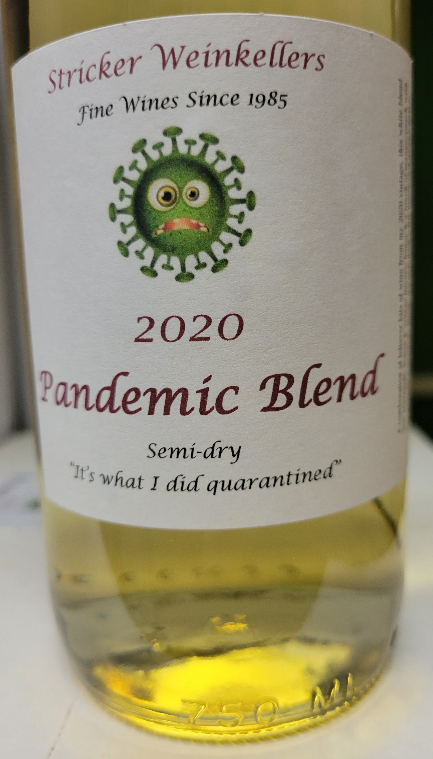
Consistency?
• There is some consistency, inconsistently
• 2020 Seyval:
o Winemaker Magazine: No Medal, score 11.67
O Illinois State Fair: Silver
O New Jersey State Fair: Double Gold, score 17.83
• 2019 Riesling
O Wine Maker Magazine: No Medal, Score 11.33
O LA Cellarmasters: Gold, score 18.125
O Illinois State Fair: Silver
O New Jersey State Fair: Gold, Best White Wine, score 16.75
• 2020 Vignoles
O Wine Maker Magazine: Silver 13.67
O Illinois State Fair: Double Gold
O New Jersey State Fair: Silver 15.875

Slide 17
Conclusions
Competing is fun and rewarding
Good tool to improve both your wine and your wine tasting/judging
Always be on the lookout for additional competitions
Don’t be shy! Toot your own horn

Slide 18
Q & A
Which are the Easiest and Hardest Categories for Competition?
Can I Compete with a Kit Wine?
Can I Enter the Same Wine in Successive Years?
Which Additives Disqualify My Wine for Competition?

Slide 19
This Photo by Unknown Author is licensed under CC BY-NC

