Slide 1
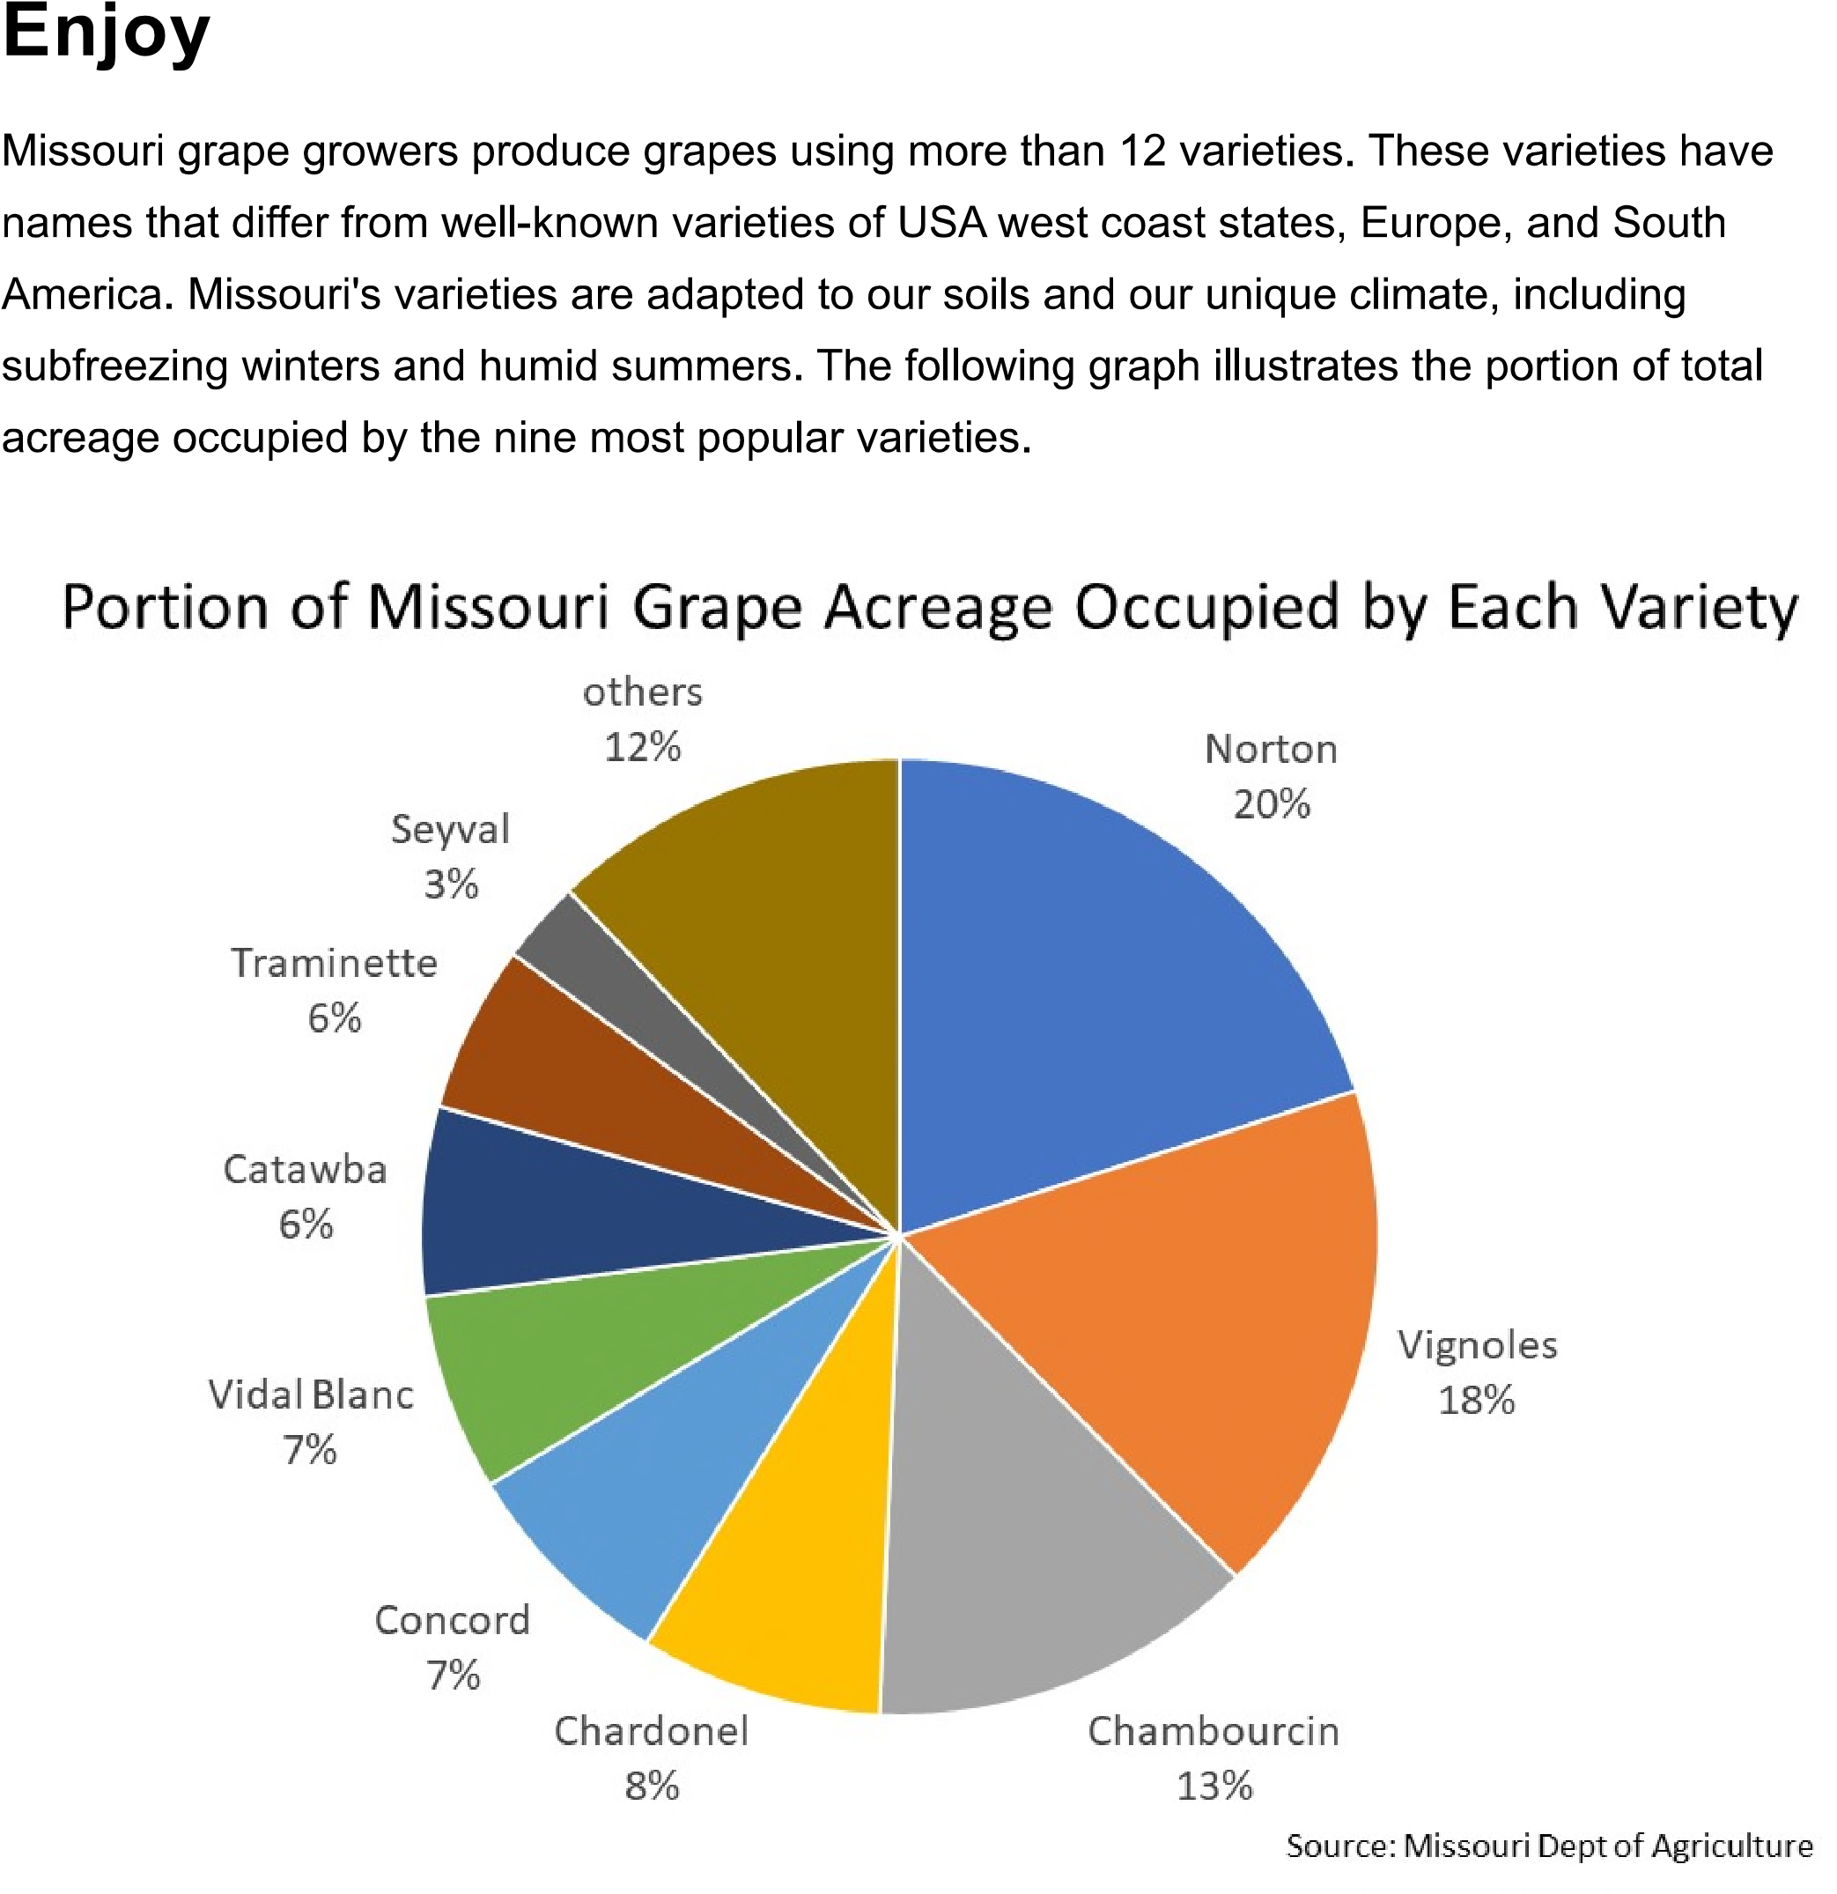

Slide 2
Cayuga
Cayuga is a hardy grape resulting from a cross between two hybrids – Schuyler and Seyval Blanc. Cayuga was developed at Cornell University in 1972.
The Cayuga grape is a large grape, significantly larger than Vignoles.
Cayuga is sometime referred to as similar to Riesling. It produces a sweeter, full body wine with bright citrus flavors.
Note it is a good option for a sparkling wine. Also note, Cayuga should be consumed within a year of bottling in order to realize the clean, crisp, zesty essence of Cayuga.
Cayuga acreage in Missouri is 60 – 70 acres, representing about 3.5% of the total grape acerage in Missouri

Slide 3
Cayuga

Slide 4
Vignoles
Vignoles is a complex hybrid wine grape presumed to have been developed by J.F. Ravat. Originally named Ravat 51. It was the result of a cross made in 1930 using Seibel 6905 (aka Le Subereux) and a clone of Pinot Noir knows as Pinot de corton. It was imported to US in 1949, but there seems to be a question as to whether our Vignoles is the same.
Mostly grown in North America, and whether our Vignoles is a variety other than Ravat or has evolved, our vignoles does not share genetic characteristics of Seibel or Pinot de corton.
Vignoles is a moderately vigorous late season bud break, with small bunches that are susceptible to Botrytis bunch rot. Vignoles average 105 days from bloom to harvest, has high sugar and high acid, has average disease resistance and is winter hardy.
Wikipedia
Vignoles is one of MO’s most versatile grapes; fruity, and can be made sweet, dry or in between.
It accounts for 15.4 % of all grapes grown in MO, covering 262.2 acres,.
Flavors or Tasting Notes: tropical fruits like pineapple, peach and apricot, and may have citrus and floral notes.
Medium Bodied, crisp and flavorful.
Food Pairings : spicy food, BBQ and tropical fruits
MO Wine Board

Slide 5
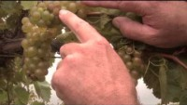
Vignoles

Slide 6
Seyval Blanc
Seyval is a hybrid. It ripens early is suited to cool climates, grown mainly in England and US.
It was created either by Bertille Seyve or his son in law Villard by crossing Seibel 5656 and Rayon d’or (Seiberl 4986) and was used to create the hybrid grape St. Pepin (?).
Seyval has citrus elements as well as minerality. It is often oaked and subjected to Malolactic.
Wikipedia
Seyval Blanc is a French-American hybrid grape that makes a dry to semi-dry, clean, crisp medium-bodied wine with an herbal, fresh flavor. When it is barrel fermented, it can take on an oak complexity indicative of Chardonel.
Seyval represents 2.5% of the grapes grown in MO covering 41.8 acres.
Flavors - herbal spices, pear and oak (if fermented in barrels)
Taste - medium-bodied, clean and crisp
Food Parings - Grilled chicken and fish, green vegetables, sushi, white cheeses, pasta & cream sauce, lemon cake & melon
MO Wine Board

Slide 7
Seyval Blanc

Slide 8
Traminette
Traminette is a cross of the French American hybrid Joannes Seyve and the German Vitis vinifera Gewurztraminier made by Herb C. Barrett in 1965 at the University of Illinois. It was found to have excellent wine quality, combined with good productivity, hardiness to disease and old hardiness.
Traminette was chosen by the Indiana Grape Council as the signature wine of Indiana.
Wikipedia
Traminette ranges from dry, semi dry to semi sweet. It is a medium body wine. Its floral aromas are met with citrus fruit, tangy acidity and a touch of spice.
Traminette represents 5% of grapes grown in MO, covering 85.3 acres.
Johannes Seyve was a French biochemist who often used Seibel grape hybrids in his breeding program. He created hybrids from native American varietals, known as vitis labrusca in 1860s. Seyve is also credited with creating Chambourcin and his brother and father are credited with creating Seyval Blanc.
Traminete, is a medium bodied wine. while floral, is less intense than its parent Gewurztraminer. It can have notes of apricot, peach, honey, rose, apple, passion fruit, pear and citrus.
Flavors – floral aromas with tangy citrus and light spice
Taste – light to medium body, complex and acidic.
Foor pairings – chicken, pasta dishes with cream sauce, seafood…

Slide 9
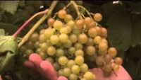
Traminette

Slide 10
Vidal Blanc
A white hybrid grape produced from Vitis vinifera variety Ugni blanc (aka Trebbiano Toscano) and another hybrid Rayon d’or created by Seibel. It was developed in the 1930s by French breeder Jean Louis Vidal. He created it for production of cognac. However, due to winter hardiness it is mostly cultivated in Canada and US.
The wine tends to be fruity with aroma notes of pineapple and grapefruit. It is acidic with high sugar potential.
Wikipedia
Vidal Blanc is medium bodied, crisp and clean typically with flavors of pear, apple and citrus fruits.
The grapes are rot resistant and can stay on the vine longer than other varietals, and thus often used to make late harvest wine. It is perhaps the most versital of MO grapes – dry, sweet, ice or late harvest, and sparkling.
Vidal Blanc represents 5.9% of grapes grown in MO, covering 98.8 acres.
Flavors - Pear, apple, citrus and other fruits
Taste – medium bodies, crisp and clean
Food pairings - seafood, chicken, cheese, fruits
Recipe - Chicken and Cheese Dip
MO Wine Board

Slide 11
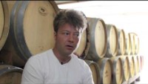
Vidal Blanc

Slide 12
Chardonel
Chardonel is a late ripening hybrid. A cross made by the New York State Agricultural Experiment Station, in 1953 of French American hybrid Seyval and vitis vinifera Chardonnay. It is combines high productivity and cold hardiness.
Wikipedia
Chardonel is a full-bodied wine. It represents 7.2% of the grapes grown in MO covering 195.5 acres.
Flavors – pear, apple, apricot, and oak
Taste – full bodied, rich and complex.
Food pairings - perhaps the most versatile for use in cooking and pairings. Chicken, fish, creamy pasta, mushrooms, etc. Try Chardonel in a variety of recipes – sauteed vegetables, pork chops, cheesy mac and cheese, deserts or cocktails

Slide 13
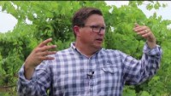
Chardonel

Slide 14
Chambourcin
Belongs to the Vitis genus in the flowering plant family Vitaceae. It is a French American hybrid, thought its parentage is uncertain. It was produced by Joannes Seyve who often used Seibel hybrids produced in the 1860s. Only been available since 1963 (?).
It produces deep colored aromatic wine. It is one of few teinturiers, i.e. whose juice is pink or red rather than clear.
Wikipedia
Chambourcin represents 11.5 % of grapes grown in MO, covering 195.5 acres. Second most in MO.
Flavors – cherry and light oak; plum, black pepper and earth notes.
Taste – smooth, medium bodies with soft tannins
Food Pairings – pork loin, bugers, red sauce, mushrooms, cobbler, chocolate cake.

Slide 15
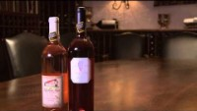
Chambourcin

Slide 16
Norton
Norton is a native American grape Cultivated in Richmond VA by Daniel Norton in the early 1800s. Official grape of MO and cornerstone of the MO wine industry.
Daniel Norton selected it from what he believed were seedlings of a long forgotten grape variety called Bland. The male parent presumably was a wild vine of vitis aestivalis. It is very similar if not the same as Cynthiana.
Wikipedia
Norton represents 17.7% of grapes grown in MO, covering 300.5 acres.
Flavors – rich wine that combines flavors of spice, vanilla, chocolate, layered with fruits, berries, ripe cherries and currants.
Taste – bold, full bodied and complex
Foor Pairings – Cheese, smoked meats, lamb, beef, blackened fish, tomato sauce, bbq sauce

Slide 17
Norton

