Slide 1
MISSOURI WINEMAKING SOCIETY
April 19, 2018
BLENDING WINE

Slide 2
WHY TO BLEND WINE:
Good Wine
Consistency
An effort to arrive at a better wine based on the grapes that the winemaker has to work with
The winemaker’s preference for end result flavor that comes from a combination of grapes

Slide 3
THE GOAL OF BLENDING:
The goal of blending is to achieve a more well balanced wine in terms of flavor, acid levels, residual sugar, color, alcohol, and all items that make up balance and body.

Slide 4
SUGGESTIONS FROM EXPERIENCED WINEMAKERS:
Have a goal in mind upfront
Blend wines that are similar in character
Know strengths and weaknesses of your different grapes and why they go together – blend grapes which counter-balance each other – blend a grape that has forward fruit flavor but low acid, tannins, or alcohol with a grape with higher acid, tannins or alcohol

Slide 5
SUGGESTIONS FROM EXPERIENCED WINEMAKER
Don’t try to fix flaws in a grape or wine by blending
Do small test blends or bench trials before blending in bulk

Slide 6
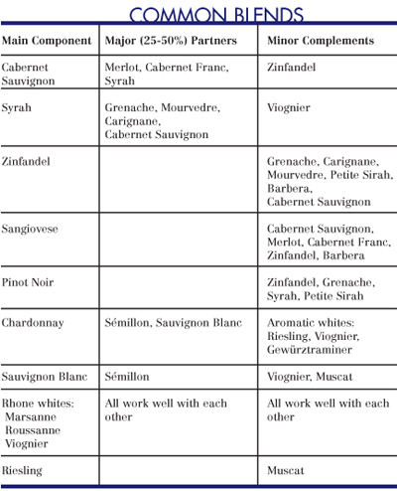

Slide 7
HOW TO BLEND:
I don’t know; I’m not experienced; hopefully Mark can help out at this point but perhaps you’ve heard of the Pearson Square or
P1 + P2 x = PB (1 + x)

Slide 8
FAMOUS BLENDS:
Côtes du Rhône
Grenache, Syrah, Mourvèdre,Cinsault,Counoise
Grenache is a grape that enjoys warm, dry, and windy climate around the Mediterranean in the south of Spain and France.
Winemakers working with what they have available and blend to make better wine

Slide 9
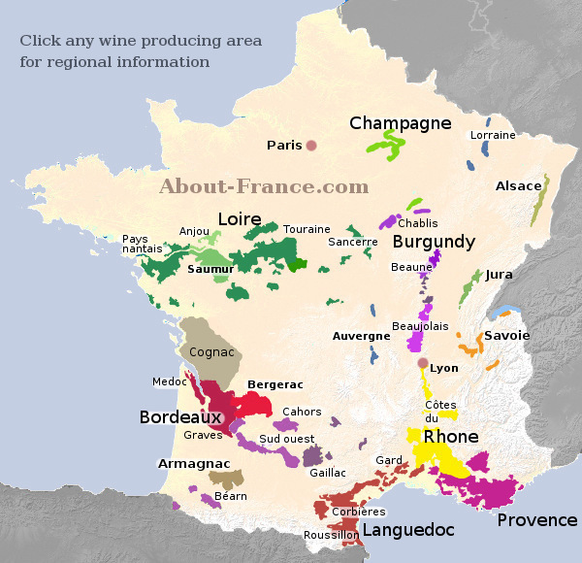

Slide 10
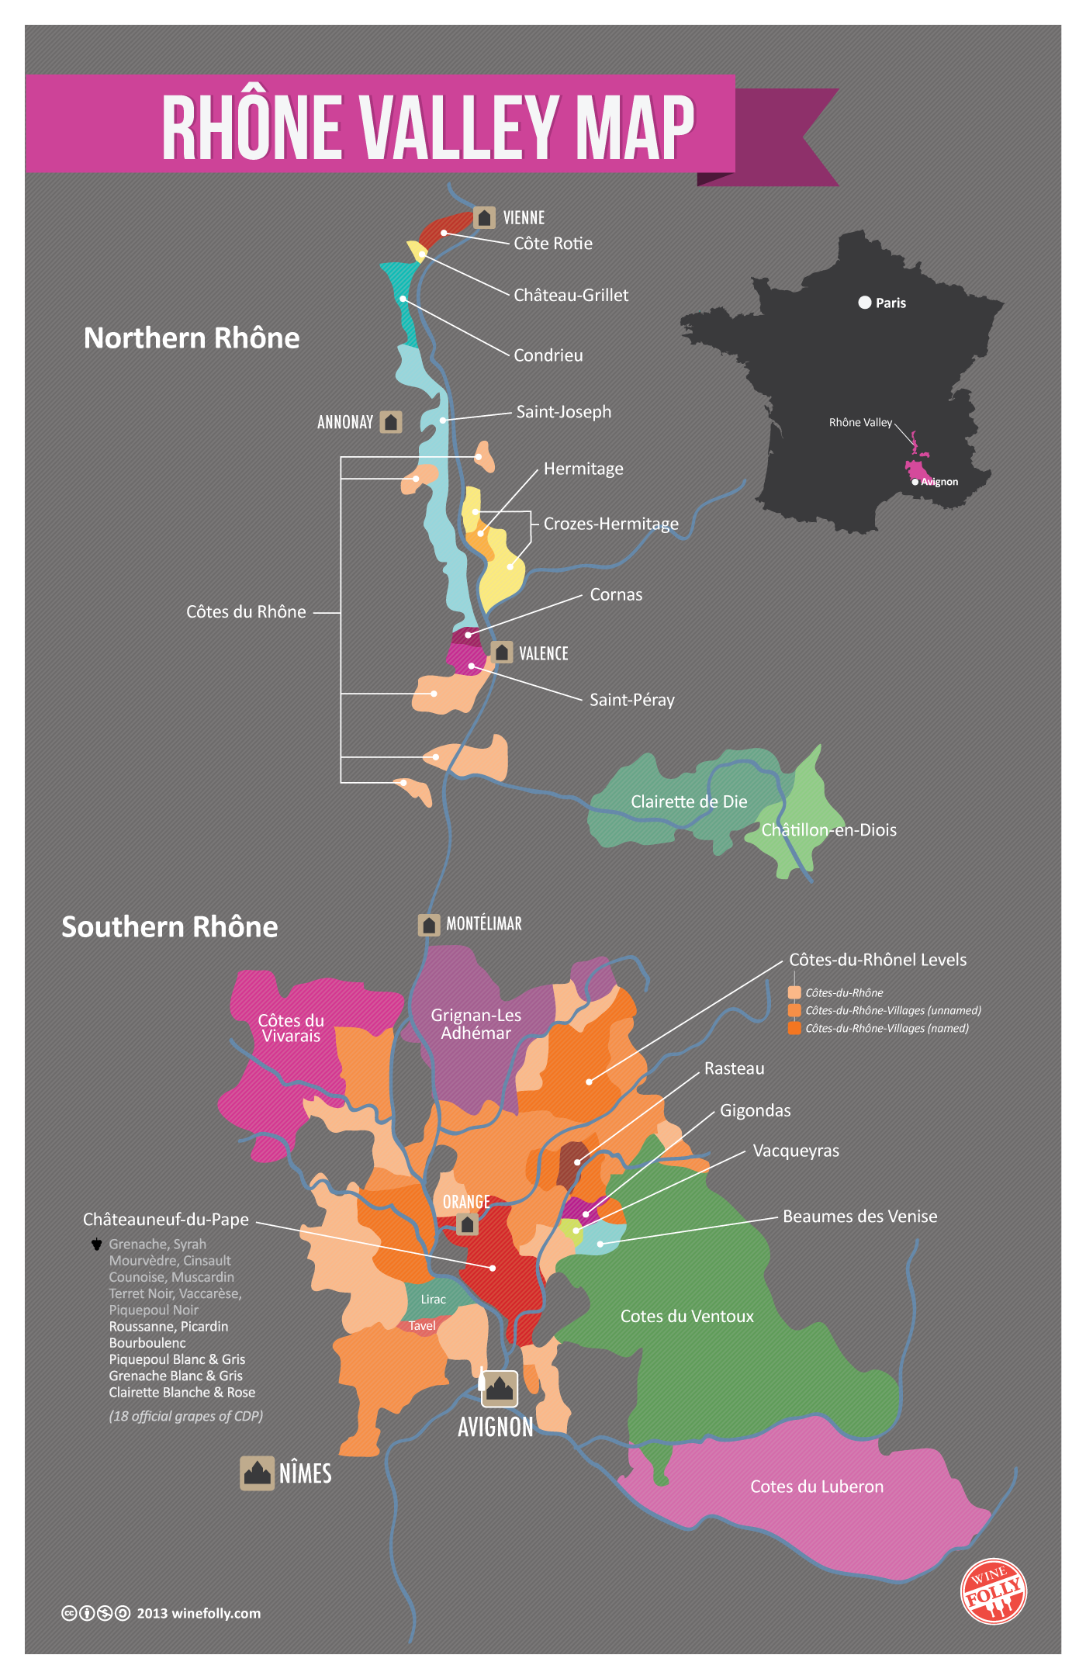

Slide 11
FAMOUS BLENDS:
Long ripening allows for high sugar capable of high alcohol levels but low tannins
Grenache balances well with Mourvèdre - a complimentary grape which thrives under the same conditions which also allows for high sugar and high alcohol but contrary to Grenache has high tannins
Chateauneuf de Pape - 13 grapes

Slide 12
Bordeaux (Claret in Britain)
Five grapes - Cabernet Sauvignon, Cabernet Franc, Merlot, Petit Verdot, Malbec and, rarely (only one winery), Carménère
Right Bank Bordeaux wines are predominantly Merlot
Left Bank Bordeaux wines are predominately Cabernet Sauvignon
While Bordeaux wines are some of the most famous wines in the world – they are blends

Slide 13
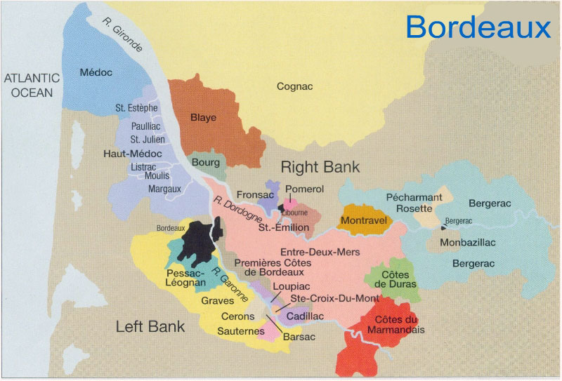

Slide 14
